Slide 1
Regression
Lee-Ad Gottlieb

Slide 2
Multiclass
So far, we’ve done binary classification
only two classes
Examples: {0,1}, {-1,1}, {-,+}, {blue, red}
What about multiclass?
K classes
Ex: {1,2,3}, {blue,red,yellow}

Slide 3
Multiclass
What about multiclass?
K classes, {1,2,3}
Reduce to binary one-vs-one problems
Is new point blue or yellow?
Is new point blue or red?
Is new point yellow or red?
Winner: majority label
If there is one…
This gives O(k²) subproblems (all pairs)

Slide 4
Multiclass
What about multiclass?
K classes, {1,2,3}
Reduce to binary one-vs-all problems
Is new point blue or not blue?
Is new point red or not red?
Is new point yellow or not yellow?
Winner: whichever one wins…
If there is one…
This gives only O(k) subproblems
A different problem: imbalanced data
Possible solution: sample equal number from blue and not blue

Slide 5
Regression
Regression: Labels in real range
Example: [0,1], [-1,1], 0-120 kph, 0-200 kg.
More general: {0,M} or {-M,M} for some M
Goal: Predict labels of unknown points

Slide 6
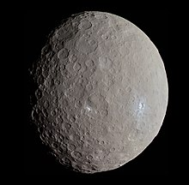
Regression
Example:
In 1801, Giuseppe Piazzi observed the dwarf planet Ceres before its transit to the sun
Where will it appear after the transit?
Gauss solved this using linear regression
Legendre also used this method for astronomical prediction

Slide 7
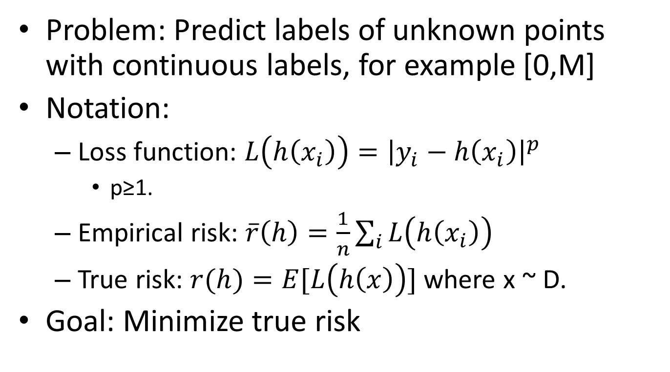
Regression
Problem: Predict labels of unknown points with continuous labels, for example [0,M]
Notation:
Loss function: $L\left(h\left(x_{i}\right)\right)={\left|y_{i}−h\left(x_{i}\right)\right|}^{p}$
p≥1.
Empirical risk: $\overline{r}\left(h\right)=\frac{1}{n}\sum_{i}{L\left(h\left(x_{i}\right)\right)}$
True risk: $r(h)=E[L\left(h\left(x\right)\right)]$ where x ~ D.
Goal: Minimize true risk

Slide 8
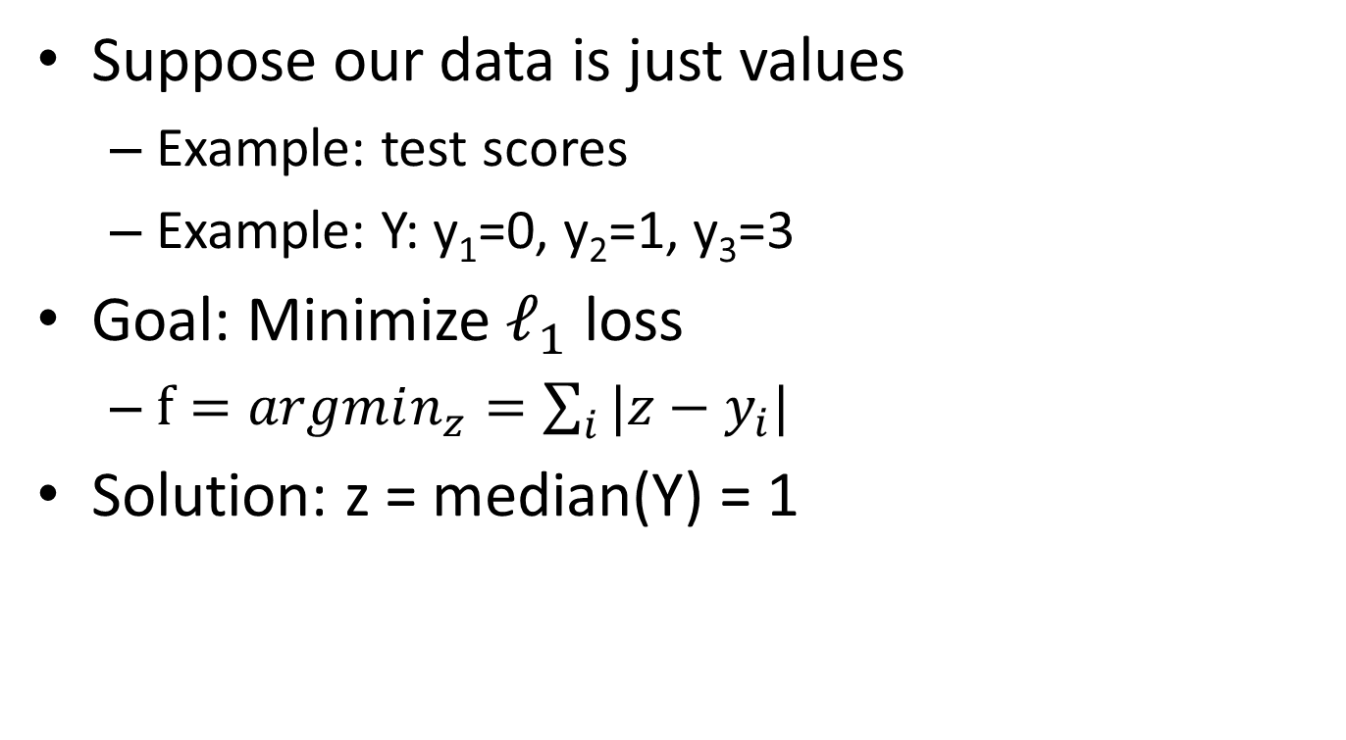
Loss functions
Suppose our data is just values
Example: test scores
Example: Y: y₁=0, y₂=1, y₃=3
Goal: Minimize $ℓ_{1}$ loss
$f=argmin_{z}=\sum_{i}{|z−y_{i}|}$
Solution: z = median(Y) = 1
0
1
3

Slide 9
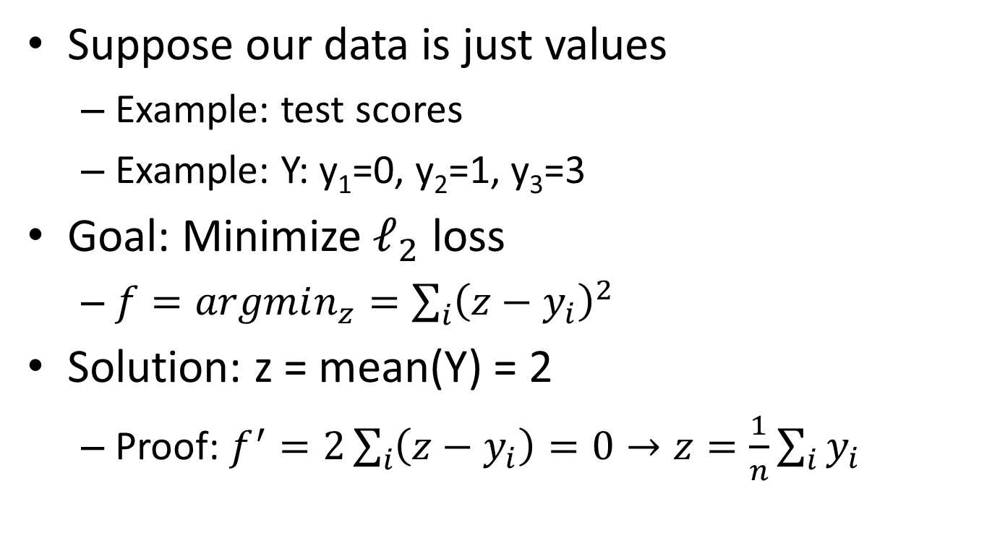
Loss functions
Suppose our data is just values
Example: test scores
Example: Y: y₁=0, y₂=1, y₃=3
Goal: Minimize $ℓ_{2}$ loss
$f=argmin_{z}=\sum_{i}{{\left(z−y_{i}\right)}^{2}}$
Solution: z = mean(Y) = 2
Proof: $f^{′}=2\sum_{i}{\left(z−y_{i}\right)=0→z=\frac{1}{n}\sum_{i}{y_{i}}}$
0
1
3

Slide 10
Regression
What function should we try to fit our data to?
Tradeoff:
Simpler function gives lower VC-dimension
Complex function can fit the data better

Slide 11
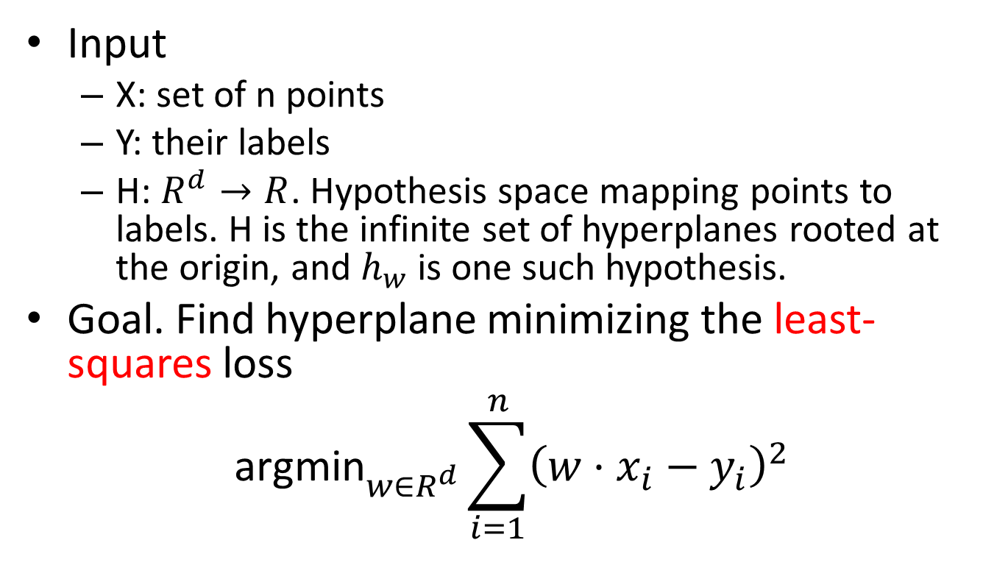
Linear regression
Input
X: set of n points
Y: their labels
H: $R^{d}→R$. Hypothesis space mapping points to labels. H is the infinite set of hyperplanes rooted at the origin, and $h_{w}$ is one such hypothesis.
Goal. Find hyperplane minimizing the least-squares loss
$${\text{argmin}}_{w∈R^{d}}\sum_{i=1}^{n}{{\left(w⋅x_{i}−y_{i}\right)}^{2}}$$

Slide 12
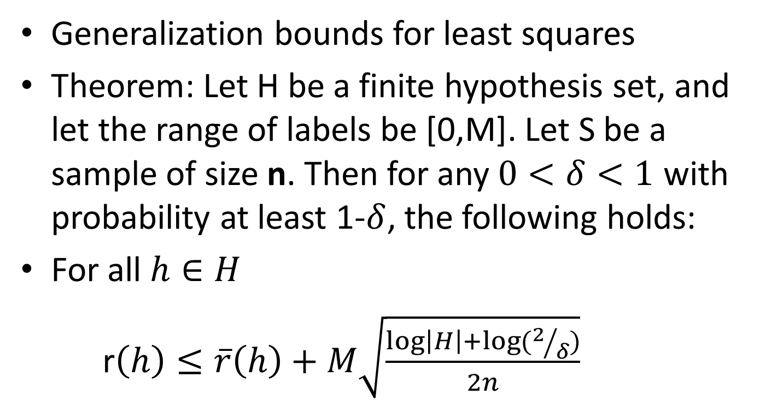
Regression
Generalization bounds for least squares
Theorem: Let H be a finite hypothesis set, and let the range of labels be [0,M]. Let S be a sample of size n. Then for any $0<δ<1$ with probability at least 1-$δ$, the following holds:
For all $h∈H$
r$\left(h\right)≤\overline{r}\left(h\right)+M\sqrt{\frac{\log\left|H\right|+\log{(2/δ)}}{2n}}$

Slide 13
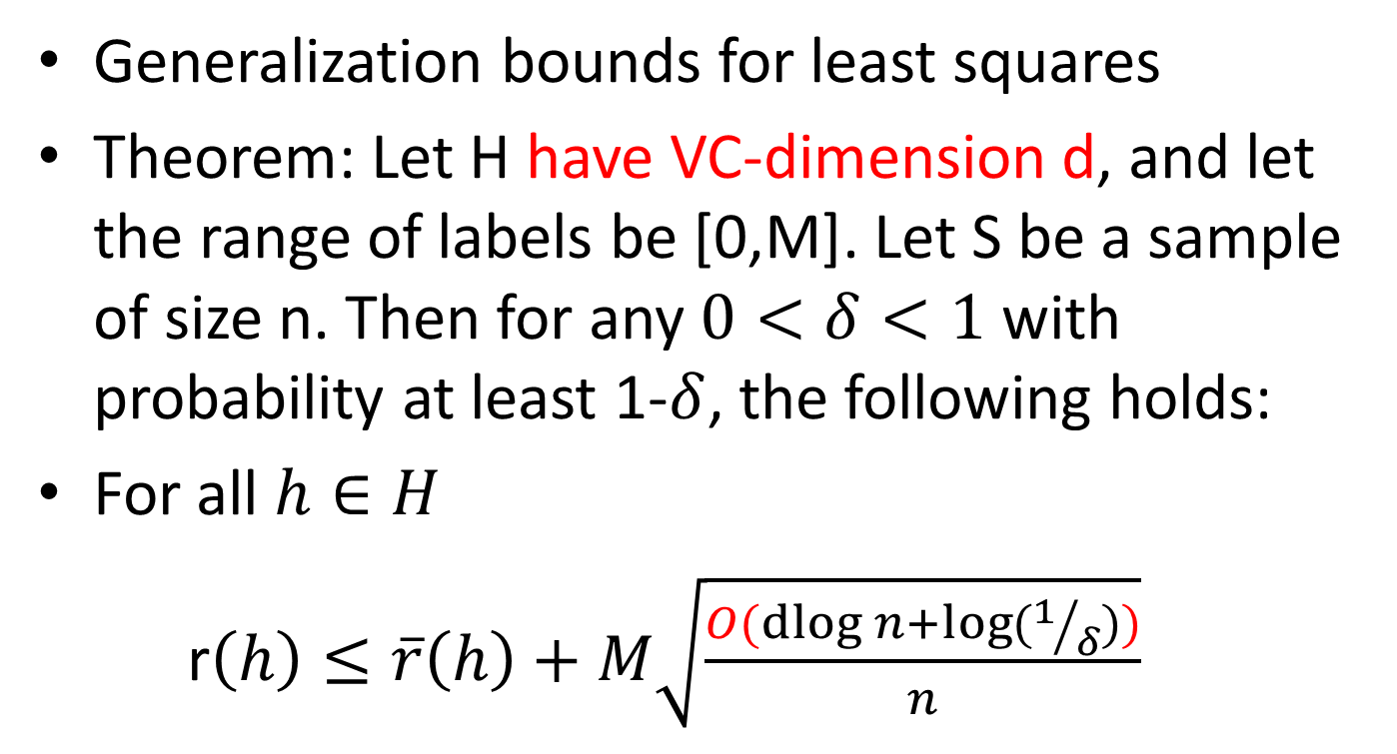
Regression
Generalization bounds for least squares
Theorem: Let H have VC-dimension d, and let the range of labels be [0,M]. Let S be a sample of size n. Then for any $0<δ<1$ with probability at least 1-$δ$, the following holds:
For all $h∈H$
r$\left(h\right)≤\overline{r}\left(h\right)+M\sqrt{\frac{O(dlog{n+\log{(1/δ))}}}{n}}$

Slide 14
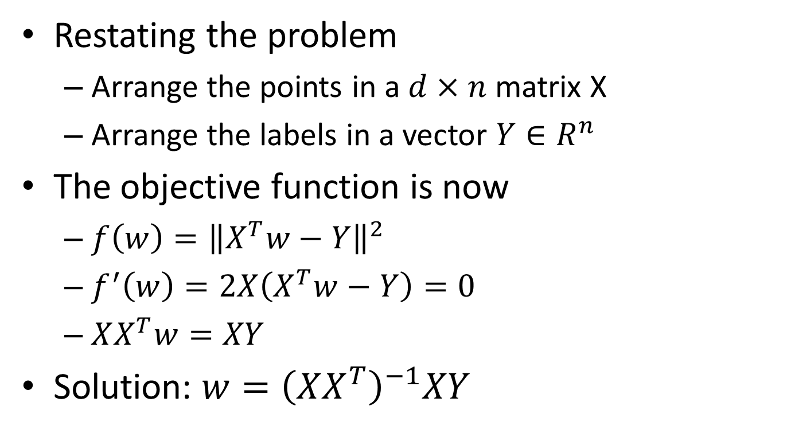
Linear regression
Restating the problem
Arrange the points in a $d×n$ matrix X
Arrange the labels in a vector $Y∈R^{n}$
The objective function is now
$f\left(w\right)={\left\|X^{T}w−Y\right\|}^{2}$
$f^{′}\left(w\right)=2X\left(X^{T}w−Y\right)=0$
$XX^{T}w=XY$
Solution: $w={\left(XX^{T}\right)}^{−1}XY$

Slide 15

Linear regression
Solution: $w={\left(XX^{T}\right)}^{−1}XY$
Question: What if $XX^{T}$ is not invertible?
Use the Pseudo-Inverse of $XX^{T}$instead!

Slide 16
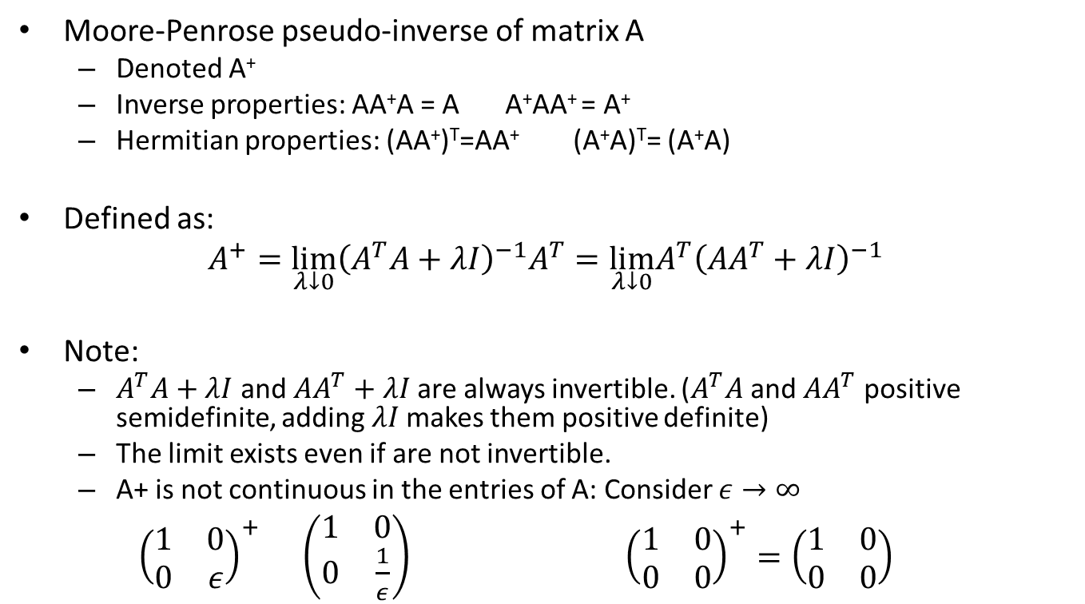
Linear regression
Moore-Penrose pseudo-inverse of matrix A
Denoted A⁺
Inverse properties: AA⁺A = A A⁺AA⁺ = A⁺
Hermitian properties: (AA⁺)^{T}=AA⁺ (A⁺A)^{T}= (A⁺A)
Defined as:
$$A^{+}=\lim_{λ↓0}{\left(A^{T}A+λI\right)}^{−1}A^{T}=\lim_{λ↓0}{A^{T}\left(AA^{T}+λI\right)}^{−1}$$
Note:
$A^{T}A+λI$ and $AA^{T}+λI$are always invertible. ($A^{T}A$ and $AA^{T}$ positive semidefinite, adding $λI$makes them positive definite)
The limit exists even if are not invertible.
A+ is not continuous in the entries of A: Consider $ε→∞$
${\left(\begin{matrix}1 & 0 \\ 0 & ε\end{matrix}\right)}^{+} \left(\begin{matrix}1 & 0 \\ 0 & \frac{1}{ε}\end{matrix}\right)$ ${\left(\begin{matrix}1 & 0 \\ 0 & 0\end{matrix}\right)}^{+}=\left(\begin{matrix}1 & 0 \\ 0 & 0\end{matrix}\right)$
A
A⁻¹
A
A⁺

Slide 17
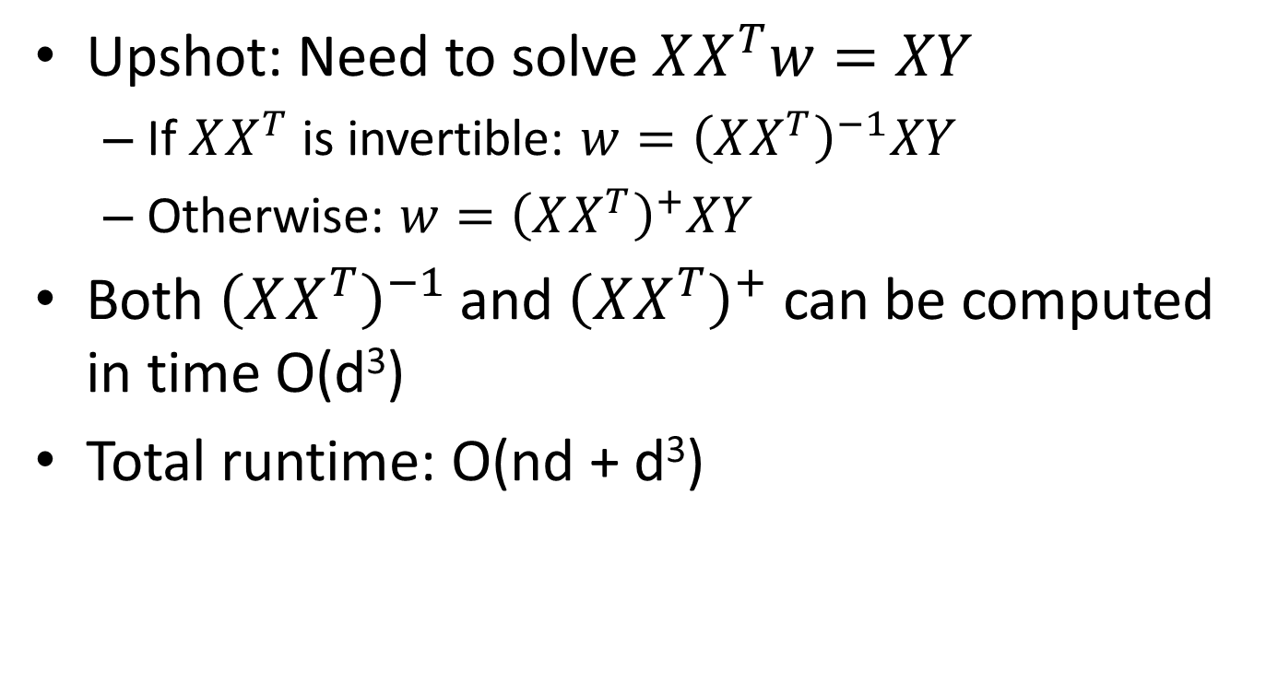
Linear regression
Upshot: Need to solve $XX^{T}w=XY$
If $XX^{T}$is invertible: $w={\left(XX^{T}\right)}^{−1}XY$
Otherwise: $w={\left(XX^{T}\right)}^{+}XY$
Both ${\left(XX^{T}\right)}^{−1}$and ${\left(XX^{T}\right)}^{+}$ can be computed in time O(d³)
Total runtime: O(nd + d³)

Slide 18
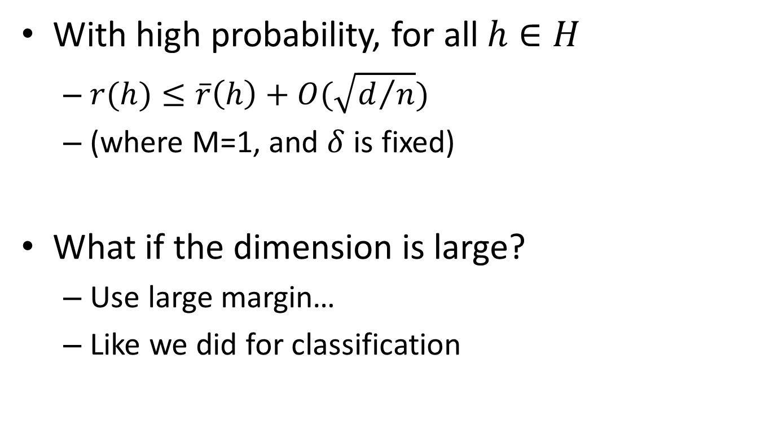
Generalization bound
With high probability, for all $h∈H$
$r(h)≤\overline{r}\left(h\right)+O(\sqrt{d/n})$
(where M=1, and $δ$ is fixed)
What if the dimension is large?
Use large margin…
Like we did for classification

Slide 19
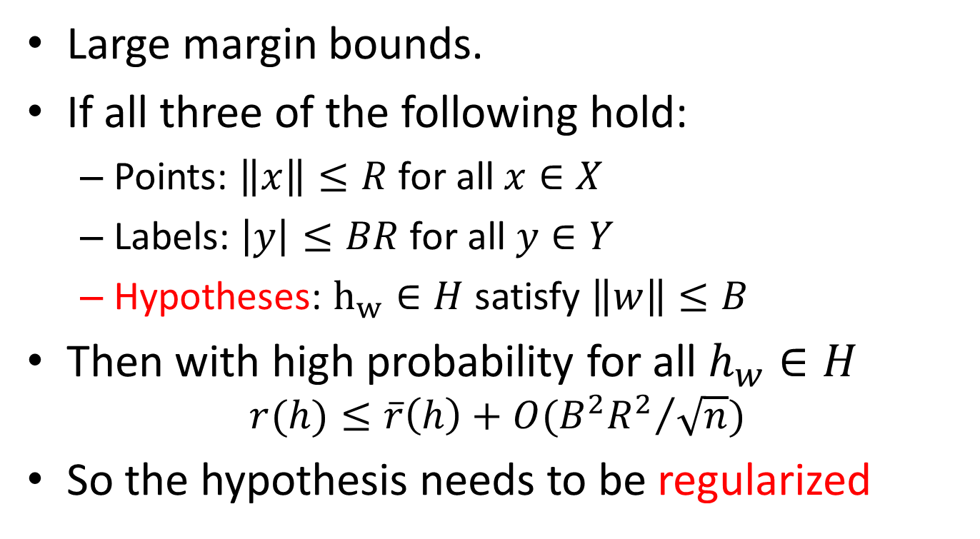
Generalization bound
Large margin bounds.
If all three of the following hold:
Points: $\left\|x\right\|≤R$ for all $x∈X$
Labels: $\left|y\right|≤BR$ for all $y∈Y$
Hypotheses: $h_{w}∈H$ satisfy $\left\|w\right\|≤B$
Then with high probability for all $h_{w}∈H$
$$r(h)≤\overline{r}\left(h\right)+O({B^{2}R^{2}}/{\sqrt{n}})$$
So the hypothesis needs to be regularized

Slide 20
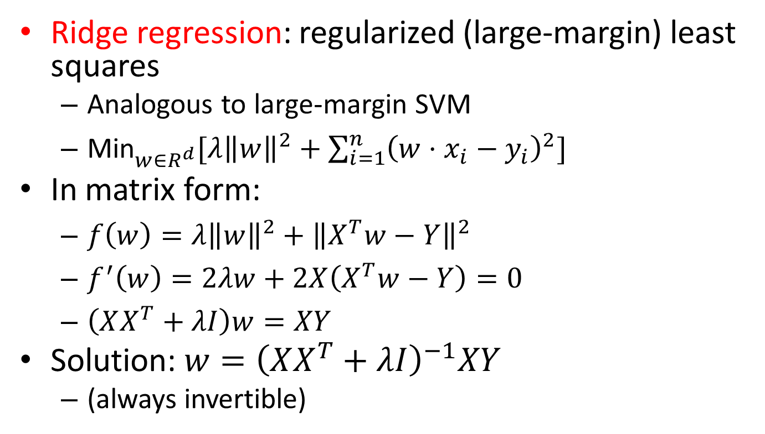
Large-margin regression
Ridge regression: regularized (large-margin) least squares
Analogous to large-margin SVM
${\text{Min}}_{w∈R^{d}}[λ{\left\|w\right\|}^{2}+\sum_{i=1}^{n}{{\left(w⋅x_{i}−y_{i}\right)}^{2}]}$
In matrix form:
$f\left(w\right)=λ{\left\|w\right\|}^{2}+{\left\|X^{T}w−Y\right\|}^{2}$
$f^{′}\left(w\right)=2λw+2X\left(X^{T}w−Y\right)=0$
$\left(XX^{T}+λI\right)w=XY$
Solution: $w={\left(XX^{T}+λI\right)}^{−1}XY$
(always invertible)

Slide 21

Non-linear function
Ridge regression
How can we handle non-linear regressors?
Kernel function (Like in kernel-SVM)
${\text{Min}}_{w∈R^{d}}[λ{\left\|w\right\|}^{2}+\sum_{i=1}^{n}{{\left(w⋅{φ(x}_{i})−y_{i}\right)}^{2}]}$

Slide 22
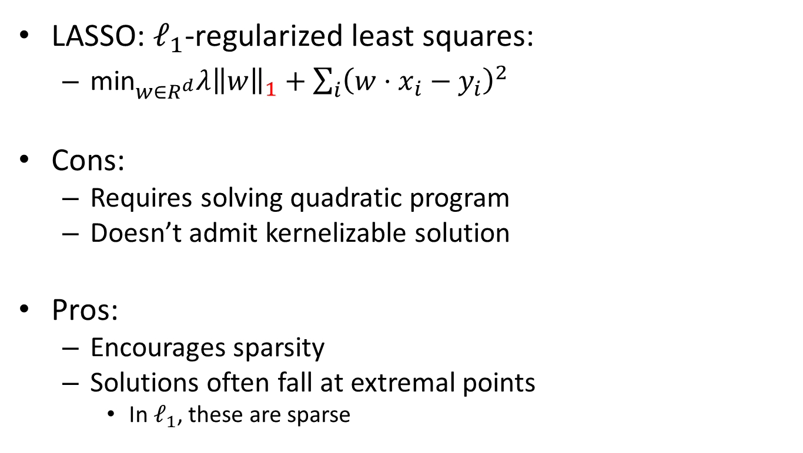
LASSO
LASSO: $ℓ_{1}$-regularized least squares:
${\text{min}}_{w∈R^{d}}λ{\left\|w\right\|}_{1}+\sum_{i}{{\left(w⋅x_{i}−y_{i}\right)}^{2}}$
Cons:
Requires solving quadratic program
Doesn’t admit kernelizable solution
Pros:
Encourages sparsity
Solutions often fall at extremal points
In $ℓ_{1}$, these are sparse
(1,0)
(1,0)
l₁
l₂

Slide 23
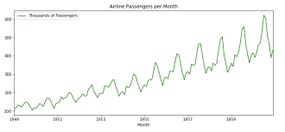
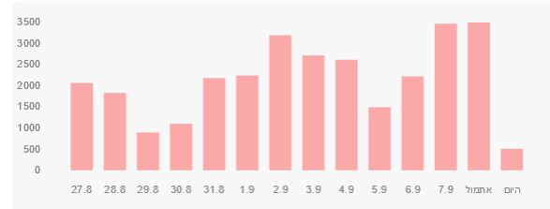
More advanced models
For time series:
ARMA – Autoregressive Moving Average
ARIMA – Autogressive Integrated Moving Average
Some data is cyclic.
Example: Air travel, Corona patients

